Slide 1
Data Science

Slide 2


Slide 3
Data Science Framework
Data Exploration, Domain Knowledge, gather more relevant data from business or from outside
Data Cleaning - check for missing values, check for duplicates, check for un realistic values
Feature Engineering
Feature Extraction - extract important information from data
Feature Selection - select the more important feature to predict label
Pre-processing - changing format of data so that it can be processed by Machine Learning algorithm
Apply Machine Learning Algorithm
Performance Analysis
Tuning - improvement in performance of ML Model
Export the trained model for production
Deployment to Production
Monitoring of performance in Production

Slide 4
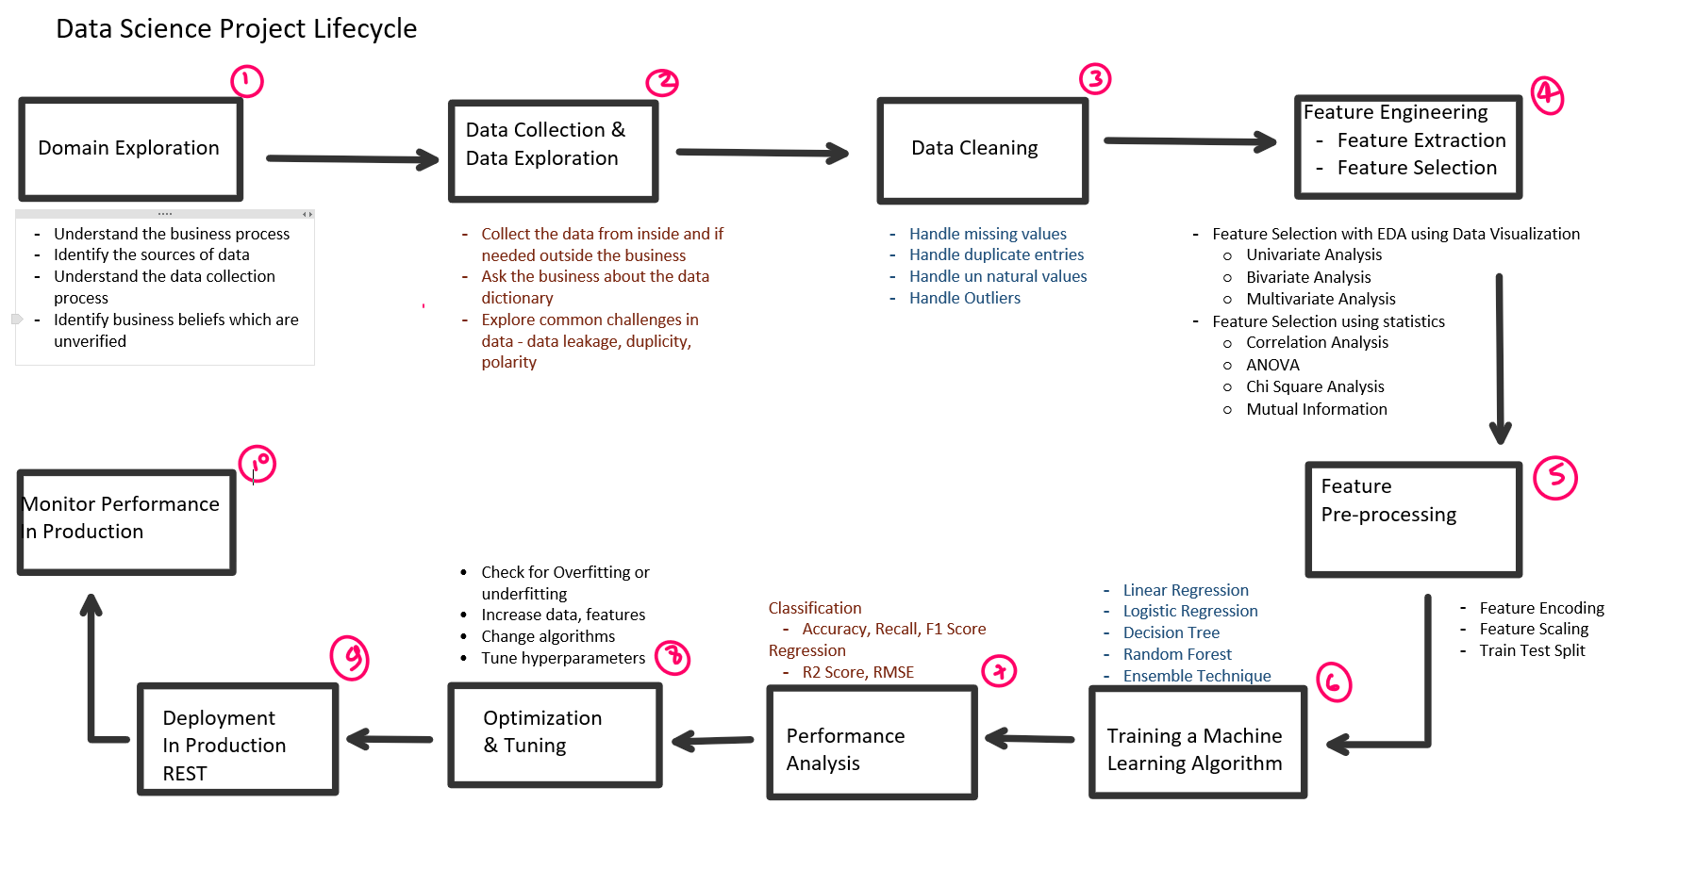

Slide 5
Data Science v/s Data Analytics
Data Science | Data Analytics
You have a question, you’re trying to get to an answer and you don’t necessarily know at the beginning if it’s going to work. “You have a question, you don't know if you can find an answer”. | You have a question, which you know is answerable. You are applying known methods to answer the question. “You are answering a question”

Slide 6
Experimentation Code should focus on -
Understandability
Markdown cells to describe our observations and assumptions
Small pieces of code for the actual logic
Lots of visualizations and counts
Minimal abstractions
Most code shouldn’t be in functions (should feel more object-oriented)

Slide 7
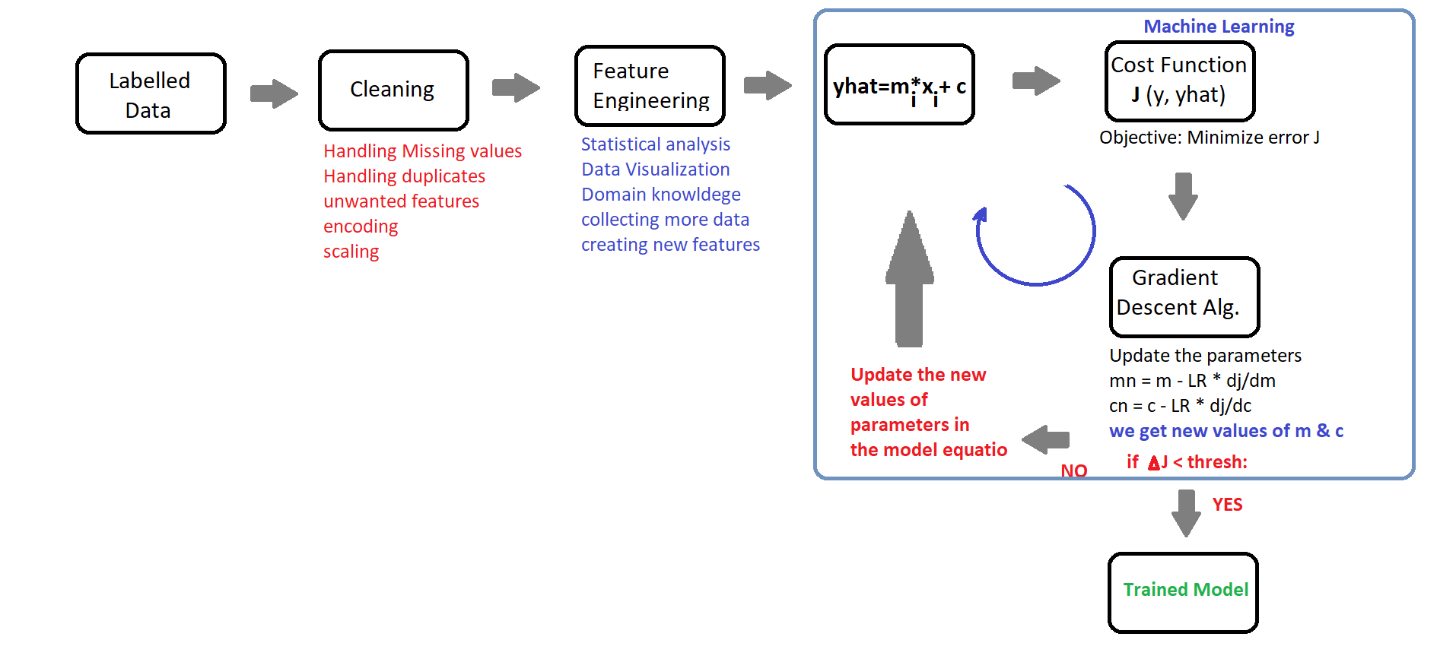
Pipeline for Data Science

Slide 8
EDA with Visualization -
Univariate visualization of and summary statistics for each field in the raw dataset
Bivariate visualization and summary statistics for assessing the relationship between each variable in the dataset and the target variable of interest (e.g. time until churn, spend)
Multivariate visualizations to understand interactions between different fields in the data
Dimensionality reduction to understand the fields in the data that account for the most variance between observations and allow for the processing of a reduced volume of data
Clustering of similar observations in the dataset into differentiated groupings, which by collapsing the data into a few small data points, patterns of behavior can be more easily identified

Slide 9
Feature Selection Best Practices
Data Visualization
Correlation Analysis
Variability Analysis
ANOVA
Chi Square Test
Clustering Analysis
Mutual information
Feature Importances
Lasso
Backward and Forward Chaining

Slide 10
Categorical V/s Continuous | Probability Distribution analysis - using distplot Swarm plot and boxplot ANOVA - f_classif Mutual Information - mutual_information_classif
Continuous v/s continuous | Scatterplot Correlation Analysis ANOVA - f_regress Mutual Information - mutualin_formation_regress
Categorical v/s Categorical | Barplot - of ratio of frequency/count in multiple groups Chi Square Test Mutual Information - mutual_information-classif Histogram/countplot

Slide 11
Some common methods for dealing with missing values include:
dropping instances
dropping attributes
imputing the attribute mean for all missing values
imputing the attribute median for all missing values
imputing the attribute mode for all missing values
using regression to impute attribute missing values

Slide 12
Take the column with missing value as label – y and rest features including actual label as x
Split train and test – train should contain those rows where we don’t have missing values in y
Test should contain those rows where we have missing values in y
Build a KNN model using train data and make predictions using trained model.
Replace missing values in y with corresponding predictions

Slide 13
Handling Missing Values
# Drop the columns where all elements are missing values:
df.dropna(axis=1, how='all')
# Drop the columns where any of the elements are missing values
df.dropna(axis=1, how='any')
# Keep only the rows which contain 2 missing values maximum
df.dropna(thresh=2)
# Drop the columns where any of the elements are missing values
df.dropna(axis=1, how='any')
# Fill all missing values with the mean of the particular column
df.fillna(df.mean())
# Fill any missing value in column 'A' with the column median
df['A'].fillna(df['A'].median())
# Fill any missing value in column 'Depeche' with the column mode
df['Depeche'].fillna(df['Depeche'].mode())

Slide 14
Machine Learning Notes

Slide 15
Machine Learning
The algorithms from Artificial Intelligence which can learn from data
Supervised Learning
Predicting future, classifying observation.
- Requires Labelled Data
- Learn from past data
Unsupervised Learning
Pattern Recognition
- Requires unlabelled data
- Learn in Realtime
Reinforcement Learning
Feedback Based Learning
Training process is very expensive
Time Series Forecasting
Forecasting future values based on previous trends.
Ex – Stock prices prediction
Regression
Target Variable is a continuous Variable.
Ex-Housing prices Prediction
Classification
Target Variable is Categorical Feature.
Ex-Churn Prediction, Digit Classification
Dimensionality Reduction
Merging features, feature Extraction
Clustering
Categorization of observations
Ex – Customer segmentation
Anomaly Detection
Detecting suspicious observation.
Ex- Fraud Detection
Recommendation System
Product Recommendation

Slide 16
Supervised Learning

Slide 17
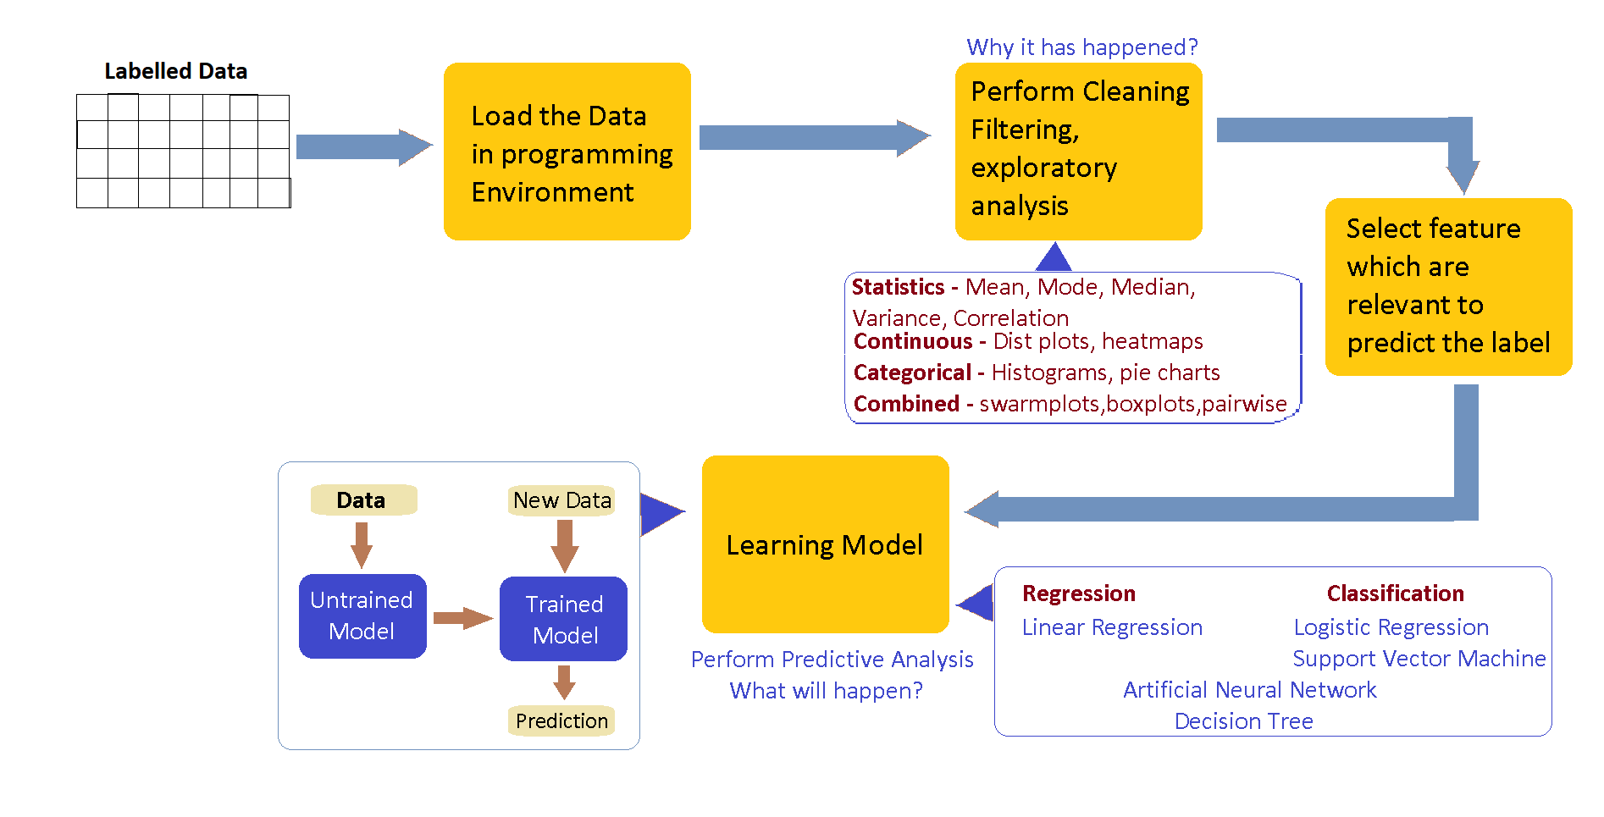

Slide 18
Regression
Linear Models
Linear Regression
Linear SVM
Non Linear Models
Decision Tree
Artificial Neural Networks
Support Vector Machine

Slide 19
Classification
Linear Models
Logistic Regression
Linear SVM
Linear Discriminant Analysis
Naïve Bayes
Non Linear Models
Decision Tree
Artificial Neural Networks
Support Vector Machine
K Nearest Neighbours

Slide 20
Time Series Forecasting
No Trend Models
ARIMA
Exponential Smoothing
Trend Based Models
Polynomial Regression
Exponential Regression

Slide 21
Supervised Learning Linear Regression

Slide 22
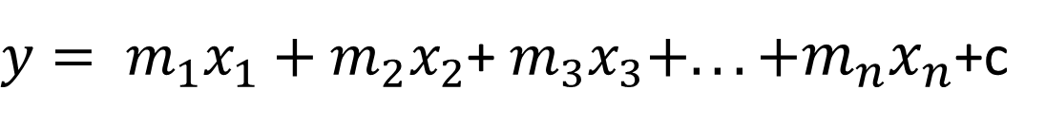
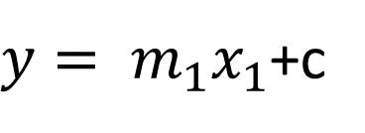
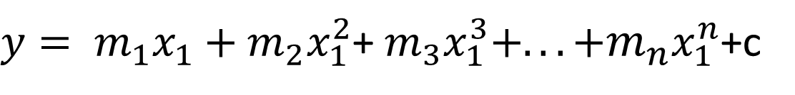
Linear Regression
Univariate Linear Regression
$y= m_{1}x_{1}$+c
Multiple Linear Regression
$y= m_{1}x_{1}+m_{2}x_{2}$+ $m_{3}x_{3}+.. .+m_{n}x_{n}$+c
Polynomial Linear Regression
$y= m_{1}x_{1}+m_{2}x_{1}^{2}$+ $m_{3}x_{1}^{3}+.. .+m_{n}x_{1}^{n}$+c

Slide 23
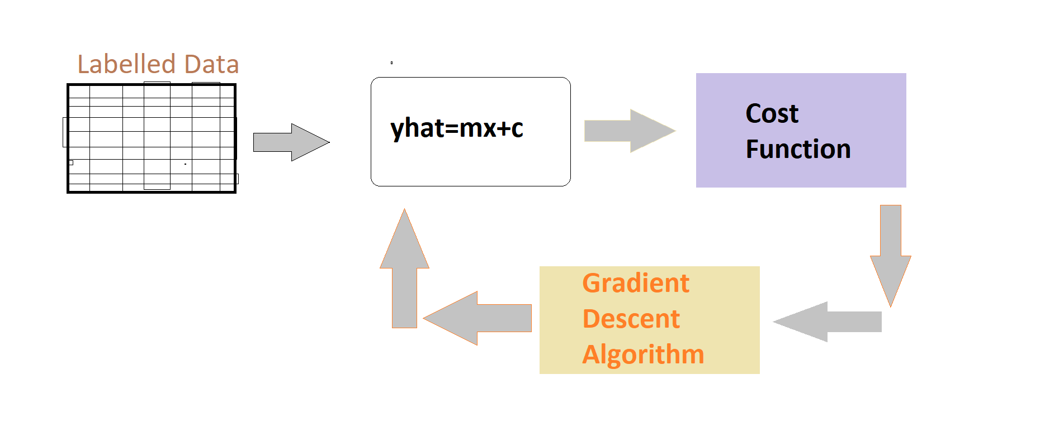
Linear Regression

Slide 24




Linear Regression
Regression Equation:
$$\hat{y}=mx+c$$
$$m_{i},c$$
Parameters
$$j\left(m_{i},c \right)=\frac{1}{2n}\sum_{i=1}^{n}{{(y_{i}−\hat{y_{i}})}^{2}}$$
Cost Function:
Goal
$${}_{m_{i},c}^{minimize}{ J\left(m_{i},c\right)}$$

Slide 25


Gradient Descent Algorithm
Linear Regression
Repeat Until converge
simultaneously update$,j=0,j=1$
where, w=parameter (coefficient & constant)
Here w= m,c
$$w_{j}≔w_{j}−lr\frac{∂}{∂w}J\left(w_{j} \right)$$

Slide 26
Linear Regression
Linear Regression Use cases
Real Estate
To model residential home prices as a function of the home's living area, bathrooms, number of bedrooms, lot size.
To analyze the effect of a proposed radiation treatment on reducing tumor sizes based on patient attributes such as age or weight.
To predict demand for goods and services. For example, restaurant chains can predict the quantity of food depending on weather.
To predict company’s sales based on previous month’s sales and stock prices of a company.
Medicine
Demand Forecasting
Marketing

Slide 27
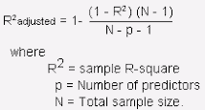
Linear Regression
Short Notes –
In linear regression we assume that there is a linear relationship between dependent variable and independent variables.
R- Squared value gives how much variance model has learnt or explained and statistical measure of how close the data are to be the fitted regression

Slide 28
Supervised Learning Logistic Regression

Slide 29
Logistic Regression
Logistic regression is a binary classification model. It’s a linear model which cuts the plane.
While testing the model in test dataset you create a confusion matrix and check metrics like Accuracy, Precision, Recall, F1 Score and Support.
1. TN / True Negative: case was negative and predicted negative
2. TP / True Positive: case was positive and predicted positive
3. FN / False Negative: case was positive but predicted negative
4. FP / False Positive: case was negative but predicted positive

Slide 30
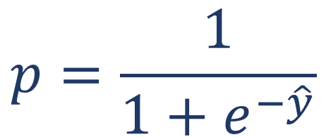
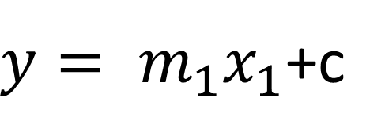
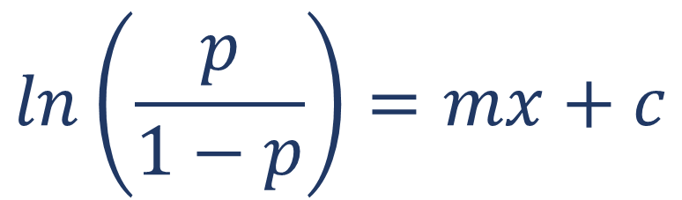
Logistic Regression
Linear Regression
Sigmoid
Function
Logistic Regression
$$p=\frac{1}{1+e^{−\hat{y}}}$$
$$ln\left(\frac{p}{1−p}\right)=mx+c$$
$y= m_{1}x_{1}$+c

Slide 31
Advantages
Logistic Regression
Lots of ways to regularize your model, and you don’t have to worry as much about your features being correlated.
Interpretability is good in case of Logistic Regression.
Use it if you expect to receive more training data in the future that you want to be able to quickly incorporate into your model, because training speed is lesser in case of logistic regression.

Slide 32
Supervised Learning Decision Tree

Slide 33
Decision Tree
It is a supervised multi-class classifier
It can be used for both classification (if we have to predict categorical variable) and regression (if we have to predict real number). Widely used in classification.
In this technique we split the population into two or more homogeneous sets based on most significant splitter using input variables
Pruning: to avoid over fitting. We allow the tree to grow completely first and then prune according to the cross-validation results.

Slide 34
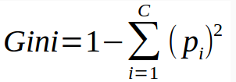

Decision Tree
Gini Index: measures the quality of split
Measures the amount of randomness in the data.
Minimizes the misclassification, Tend to find the largest class.
Gini index for a node is sum of squares of probability of the class.
Entropy: amount of uncertainty in the data
Measure of information gain, how much information is explained by each variable
Finds the group of classes that make up less than 50% of the data.
Entropy for exploratory analysis.

Slide 35
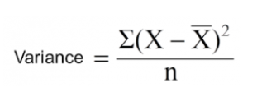
Decision Tree
Variance (Regression Tree): - Measures the variance in a continuous parameter
The impurity of a node is measured by the Least-Squared Deviation (LSD).
Calculate variance for each node.
Calculate variance for each split as weighted average of each node variance.

Slide 36
Advantages
Decision Tree
Easy to interpret and explain. Trees can be visualized.
The cost of using the tree (i.e., predicting data) is logarithmic in the number of data points used to train the tree.
They easily handle feature interactions and they’re non-parametric, so you don’t have to worry about outliers or whether the data is linearly separable
Possible to validate a model using statistical tests. That makes it possible to account for the reliability of the model.

Slide 37
Disadvantages
Decision Tree
Decision Trees don’t support online learning, so you have to rebuild your tree when new examples come on.
Decision-tree learners can create over-complex trees that do not generalise the data well. This is called overfitting. Mechanisms such as pruning (not currently supported), setting the minimum number of samples required at a leaf node or setting the maximum depth of the tree are necessary to avoid this problem.
Decision trees can be unstable because small variations in the data might result in a completely different tree being generated.

Slide 38
Business Scenarios
Decision Tree
Among patients profile, who will respond better with such treatment
Among customers, Find profile of those who will attrite vs. those will stay with the business
Among applicants, Find which are the applicants, who can be fraud (such as cases of account take over)
Among prospect of home loan pool, Find who are the prospects customer, who will switch over their home loan
Find who among current base will move into delinquency

Slide 39
Algorithms tuning parameters
Decision Tree
criterion : string, optional (default=”gini”) | The function to measure the quality of a split. Supported criteria are “gini” for the Gini impurity and “entropy” for the information gain.
max_depth : int or None, optional (default=None) | The maximum depth of the tree. If None, then nodes are expanded until all leaves are pure or until all leaves contain less than min_samples_split samples.
min_samples_split : int, float, optional (default=2) | The minimum number of samples required to split an internal node
min_samples_leaf : int, float, optional (default=1) | The minimum number of samples required to be at a leaf node. A split point at any depth will only be considered if it leaves at least min_samples_leaf training samples in each of the left and right branches. This may have the effect of smoothing the model, especially in regression.
max_features : int, float, string or None, optional (default=None) | The number of features to consider when looking for the best split: If “auto”, then max_features=sqrt(n_features). If “sqrt”, then max_features=sqrt(n_features). If “log2”, then max_features=log2(n_features). If None, then max_features=n_features.
max_leaf_nodes : int or None, optional (default=None) | Grow a tree with max_leaf_nodes in best-first fashion. Best nodes are defined as relative reduction in impurity. If None then unlimited number of leaf nodes.
min_impurity_decrease : float, optional (default=0.) | A node will be split if this split induces a decrease of the impurity greater than or equal to this value.
class_weight : dict, list of dicts, “balanced”, default=None | Weights associated with classes in the form {class_label: weight}. If not given, all classes are supposed to have weight one.

Slide 40
Supervised Learning Random Forest

Slide 41
Random Forest
It is a supervised multi-class classifier. A black box model.
It can be used for both classification and regression. Widely used in classification.
Implements ensemble: method for combining weak learners in an attempt to produce strong learners. (eg: 1 ant cannot kill an elephant, but 1000 ants can). Here week learners are decision trees (multiple decision trees are built).
In Random Forest, we grow multiple trees as opposed to a single tree as in decision tree model. Each tree will give an output. The majority of that output is considered as classification, Average in regression.

Slide 42
Advantages
Random Forest
It runs efficiently on large databases.
It can handle thousands of input variables without variable deletion.
It gives estimates of what variables are important in the classification.
It generates an internal unbiased estimate of the generalization error as the forest building progresses.
It has an effective method for estimating missing data and maintains accuracy when a large proportion of the data are missing.

Slide 43
Supervised Learning Artificial Neural Network

Slide 44
ANN
Artificial Neural Networks are models that are inspired by the structure and/or function of biological neural networks.
They are a class of pattern matching that are commonly used for regression and classification problems but are really an enormous subfield comprised of hundreds of algorithms and variations for all manner of problem types.

Slide 45
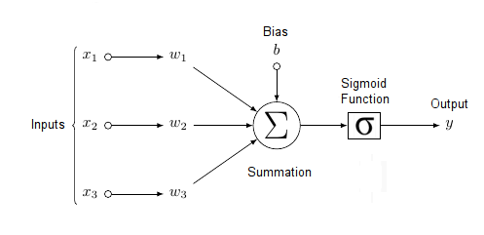
Elements of Neural Networks
ANN
1. No Computation on Input layer Neurons
2. Two process on every computational Neuron.
Weighted Sum
Activation Function
Notes:
Each neuron within the network is usually a simple processing unit which takes one or more inputs and produces an output. At each neuron, every input has an associated weight which modifies the strength of each input. The neuron simply adds together all the inputs and calculates an output to be passed on.

Slide 46
Advantages of Neural Networks
ANN
A neural network can perform tasks that a linear program can not.
When an element of the neural network fails, it can continue without any problem by their parallel nature.
A neural network learns and does not need to be reprogrammed.
It can be implemented in any application.
It can be performed without any problem.

Slide 47
Limitations of Neural Networks
ANN
The neural network needs the training to operate.
The architecture of a neural network is different from the architecture of microprocessors, therefore, needs to be emulated.
Requires high processing time for large neural networks.

Slide 48
Applications of Neural Networks
ANN
Application | Architecture / Algorithm | Activation Function
Process modeling and control | Radial Basis Network | Radial Basis
Machine Diagnostics | Multilayer Perceptron | Tan- Sigmoid Function
Portfolio Management | Classification Supervised Algorithm | Tan- Sigmoid Function
Target Recognition | Modular Neural Network | Tan- Sigmoid Function
Medical Diagnosis | Multilayer Perceptron | Tan- Sigmoid Function
Credit Rating | Logistic Discriminant Analysis with ANN, Support Vector Machine | Logistic function

Slide 49
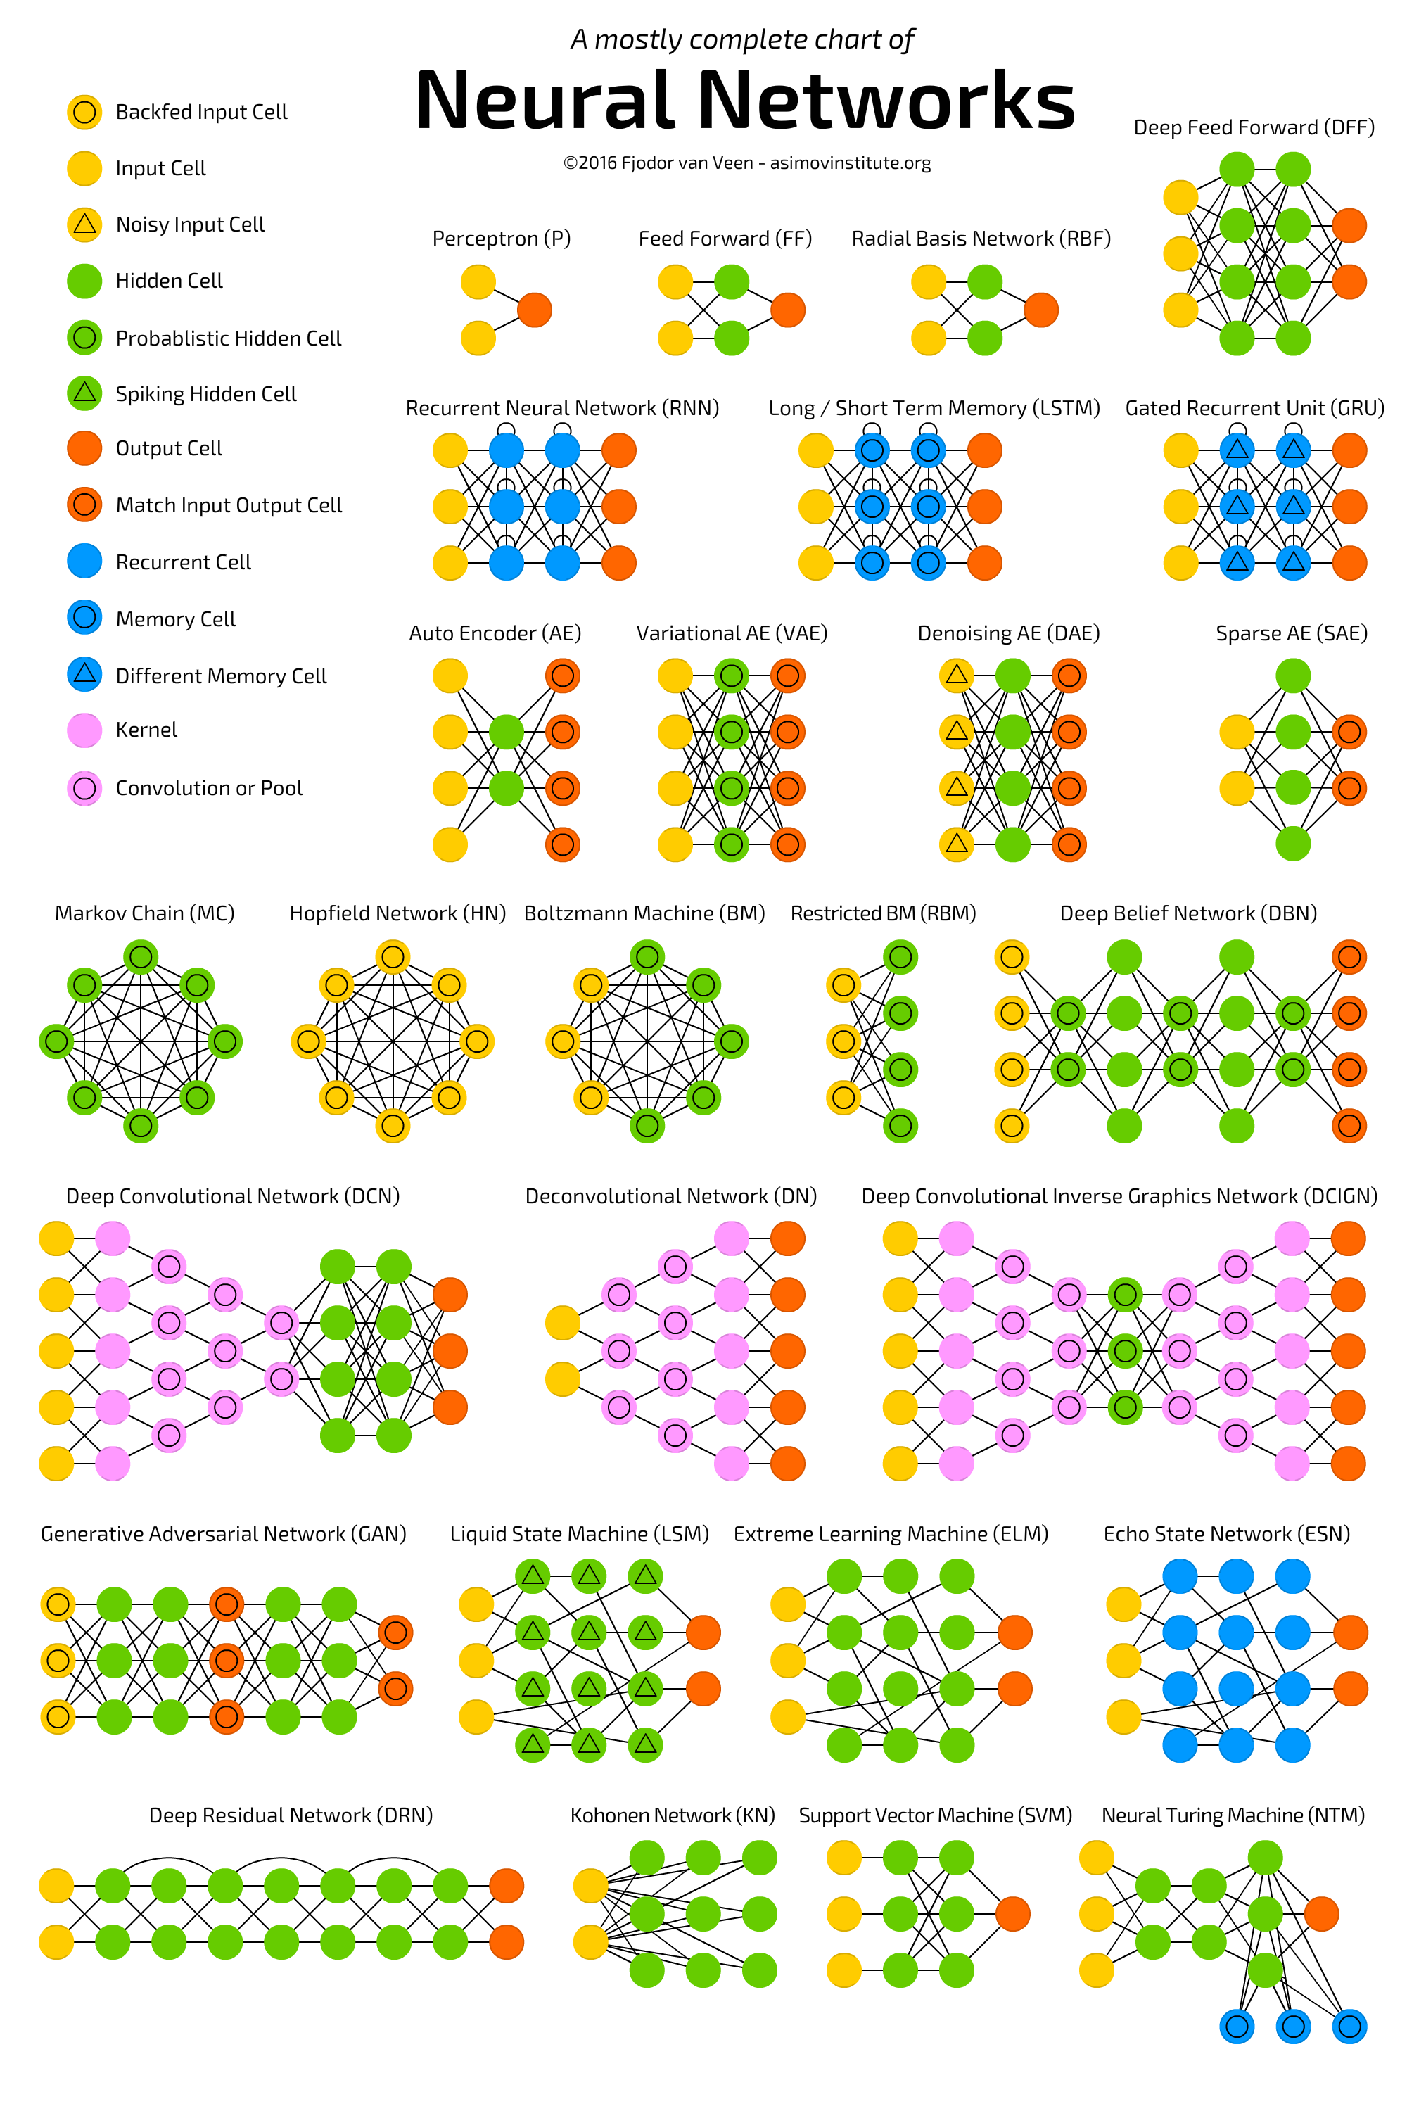

Slide 52
Algorithms tuning parameters
Artificial Neural Network
hidden_layer_sizes : tuple, length = n_layers - 2, default (100,) | The ith element represents the number of neurons in the ith hidden layer.
activation : {‘identity’, ‘logistic’, ‘tanh’, ‘relu’}, default ‘relu’ Activation function for the hidden layer. | ‘identity’, no-op activation, useful to implement linear bottleneck, returns f(x) = x ‘logistic’, the logistic sigmoid function, returns f(x) = 1 / (1 + exp(-x)). ‘tanh’, the hyperbolic tan function, returns f(x) = tanh(x). ‘relu’, the rectified linear unit function, returns f(x) = max(0, x)
learning_rate : {‘constant’, ‘invscaling’, ‘adaptive’}, default ‘constant’ Learning rate schedule for weight updates. | ‘constant’ is a constant learning rate given by ‘learning_rate_init’. ‘invscaling’ gradually decreases the learning rate learning_rate_ at each time step ‘t’ using an inverse scaling exponent of ‘power_t’. ‘adaptive’ keeps the learning rate constant to ‘learning_rate_init’ as long as training loss keeps decreasing.
solver : {‘lbfgs’, ‘sgd’, ‘adam’}, default ‘adam’ | The solver for weight optimization. ‘lbfgs’ is an optimizer in the family of quasi-Newton methods. ‘sgd’ refers to stochastic gradient descent. ‘adam’ refers to a stochastic gradient-based optimizer
learning_rate_init : double, optional, default 0.001 | The initial learning rate used. It controls the step-size in updating the weights. Only used when solver=’sgd’ or ‘adam’.
max_iter : int, optional, default 200 | Maximum number of iterations.
tol : float, optional, default 1e-4 | Tolerance for the optimization. When the loss or score is not improving by at least tol for n_iter_no_change consecutive iterations,
verbose : bool, optional, default False | Whether to print progress messages to stdout.

Slide 53
Algorithms tuning parameters
Support Vector Machine
C : float, optional (default=1.0) | Penalty parameter C of the error term.
kernel : string, optional (default=’rbf’) | Specifies the kernel type to be used in the algorithm. It must be one of ‘linear’, ‘poly’, ‘rbf’, ‘sigmoid’, ‘precomputed’ or a callable. If none is given, ‘rbf’ will be used. If a callable is given it is used to pre-compute the kernel matrix from data matrices; that matrix should be an array of shape (n_samples, n_samples).
degree : int, optional (default=3) | Degree of the polynomial kernel function (‘poly’). Ignored by all other kernels.
gamma : float, optional (default=’auto’)Kernel coefficient for ‘rbf’, ‘poly’ and ‘sigmoid’. | Current default is ‘auto’ which uses 1 / n_features, if gamma='scale' is passed then it uses 1 / (n_features * X.std()) as value of gamma. The current default of gamma, ‘auto’, will change to ‘scale’ in version 0.22. ‘auto_deprecated’, a deprecated version of ‘auto’ is used as a default indicating that no explicit value of gamma was passed.

Slide 54
Unsupervised Learning K Means Clustering

Slide 55
K Means Clustering
Categorizes given data set into ‘K’ number of clusters. Each cluster has cluster center called centroid. This clustering is done in such a way that variation with in the cluster should be less and between the clusters should be high. Here we specify K (we know what K value is prior to building model).
Randomly choose ‘K’ data points to be initial centroid.
Assign each data point to the closest centroid.
Re-compute centroids using current cluster membership.
Repeat these steps till the convergence condition met

Slide 56
K Means Clustering
Convergence/ stopping condition:
Until no/ minimum number of re-arrangements of data points to different clusters.
Until no/minimum change of centroid.
Minimum decrease in sum of square distance within cluster.
New Centroid Computation
Cluster Assignment

Slide 57
Applications
K Means Clustering
K Means Clustering algorithm is used by most of the search engines like Yahoo, Google to cluster web pages by similarity and identify the ‘relevance rate’ of search results. This helps search engines reduce the computational time for the users.
Used on acoustic data in speech understanding to convert waveforms into one of k categories (known as Vector Quantization or Image Segmentation).
Also used for choosing color palettes on old fashioned graphical display devices and Image Quantization.

Slide 58
Algorithms tuning parameters
K Means Clustering
n_clusters : int, optional, default: 8 | The number of clusters to form as well as the number of centroids to generate.
init : {‘k-means++’, ‘random’ or an ndarray}Method for initialization, defaults to ‘k-means++’ | ‘k-means++’ : selects initial cluster centers for k-mean clustering in a smart way to speed up convergence. See section Notes in k_init for more details. ‘random’: choose k observations (rows) at random from data for the initial centroids. If an ndarray is passed, it should be of shape (n_clusters, n_features) and gives the initial centers.
n_init : int, default: 10 | Number of time the k-means algorithm will be run with different centroid seeds. The final results will be the best output of n_init consecutive runs in terms of inertia.
max_iter : int, default: 300 | Maximum number of iterations of the k-means algorithm for a single run.
tol : float, default: 1e-4 | Relative tolerance with regards to inertia to declare convergence
verbose : int, default 0 | Verbosity mode.
n_jobs : int or None, optional (default=None) | The number of jobs to use for the computation. This works by computing each of the n_init runs in parallel.

Slide 59
Cheatshets

Slide 60
High Bias / Underfitting
Get more features
Try additional polynomial features
Try decreasing alpha – coefficient of regularization
No need of collecting more rows
Increase the complexity of algorithm
Try non linear algorithms

Slide 61
High Variance/ Overfitting
Get more data – examples – rows
Reduce the number of features
Try increasing alpha – coefficient of regularization
No need to get more columns
Decrease the complexity of algorithm

Slide 62
Best Practices -
Make metrics design and implementation a priority.
Starting with an interpretable model makes debugging easier.

Slide 63
Algorithm | Problem Type | Results interpretable by you? | Easy to explain algorithm to others? | Average predictive accuracy | Training speed | Prediction speed | Amount of parameter tuning needed (excluding feature selection)
KNN | Either | Yes | Yes | Lower | Fast | Depends on n | Minimal
Linear regression | Regression | Yes | Yes | Lower | Fast | Fast | None (excluding regularization)
Logistic regression | Classification | Somewhat | Yes | Lower | Fast | Fast | None (excluding regularization)
Naive Bayes | Classification | Somewhat | Somewhat | Lower | Fast (excluding feature extraction) | Fast | Some for feature extraction
Decision trees | Either | YES | Yes | Average | Fast | Fast | Some
Random Forests | Either | A little | No | Higher | Slow | Moderate | Some
Neural networks | Either | No | No | Higher | Slow | Fast | Lots

Slide 64
Algorithm | Performs well with small number of observations? | Handles lots of irrelevant features well (separates signal from noise)? | Automatically learns feature interactions? | Gives calibrated probabilities of class membership? | Parametric? (Linear) | Features might need scaling?
KNN | Yes | No | No | Yes | No | Yes
Linear regression | Yes | No | No | N/A | Yes | No (unless regularized)
Logistic regression | Yes | No | No | Yes | Yes | No (unless regularized)
Naive Bayes | Yes | Yes | No | No | Yes | No
Decision trees | No | No | Yes | Possibly | No | No
Random Forests | No | Yes (unless noise ratio is very high) | Yes | Possibly | No | No
Neural networks | No | Yes | Yes | Possibly | No | Yes

Slide 65
CNN
Always start by using smaller filters is to collect as much local information as possible, and then gradually increase the filter width to reduce the generated feature space width to represent more global, high-level and representative information
Following the principle, the number of channels should be low in the beginning such that it detects low-level features which are combined to form many complex shapes(by increasing the number of channels) which help distinguish between classes.

Slide 66
CNN
General filter sizes used are 3x3, 5x5 and 7x7 for the convolutional layer for a moderate or small-sized images and for Max-Pooling parameters we use 2x2 or 3x3 filter sizes with a stride of 2. Larger filter sizes and strides may be used to shrink a large image to a moderate size and then go further with the convention stated.
Keep adding layers until you over-fit. As once we achieved a considerable accuracy in our validation set we can use regularization components like l1/l2 regularization, dropout, batch norm, data augmentation etc. to reduce over-fitting

Slide 67
CNN
Always use classic networks like LeNet, AlexNet, VGG-16, VGG-19 etc. as an inspiration while building the architectures for your models.
Don’t touch the first layers: The first hidden layers of a neural network tend to capture universal and interpretable features, like shapes, curves, or interactions that are very often relevant across domains. We should often leave these alone, and focus on optimizing the meta² latent level further back. This may mean adding hidden layers so we don’t rush the process!

Slide 68
Dropout Best Practices:
If overfitting happens – which is usual
Use small dropouts of 20–50%, with 20% recommended for inputs. Too low and you have negligible effects; too high and you underfit.
Use dropout on the input layer as well as hidden layers. This has been proven to improve deep learning performance.
Use a larger network. You are likely to get better performance when dropout is used on a larger network, giving the model more of an opportunity to learn independent representations.

Slide 69


Slide 70
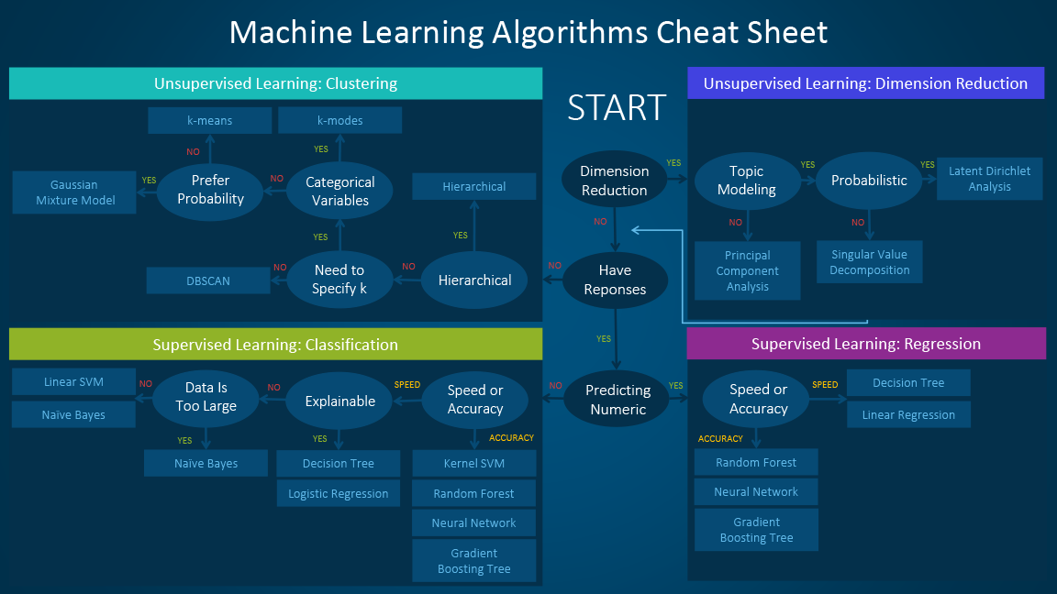

Slide 71
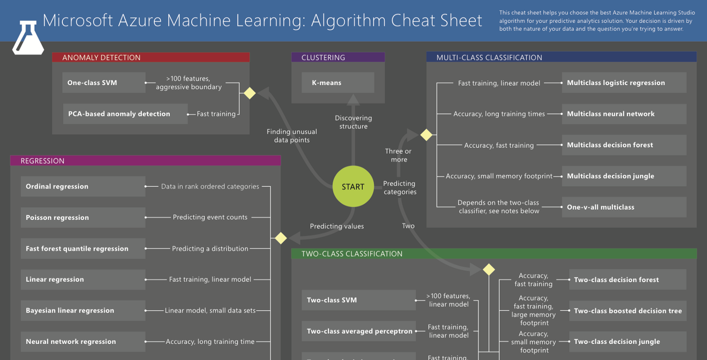

Slide 72
Algorithm Comparison
https://elitedatascience.com/machine-learning-algorithms
https://medium.com/machine-learning-bites/machine-learning-supervised-learning-algorithms-summary-76adc41b8ecc

Slide 73

In Depth
Decision Tree and Random Forest
https://jakevdp.github.io/PythonDataScienceHandbook/05.08-random-forests.html
Principal Component Analysis
https://jakevdp.github.io/PythonDataScienceHandbook/05.09-principal-component-analysis.html

